Slide 1
Sorting
Fall 2024
School of Software Engineering
South China University of Technology

Slide 2


Content
Introduction
Θ(n²) Sorting Algorithms
O(nlogn) Sorting Algorithms
Linear-Time Sorts
External sorting

Slide 3

Sorting
Sorting is a central problem in computer science
It has been studied intensively
Many algorithms have been designed
New algorithms are still being developed

Slide 4
Terminology and Notation
Sorting problem
Given a set of records r₁ , r₂ , … , r_{n} with key values k₁ , k₂ ,… , k_{n},
Arrange the records into an order s such that records r_{s1}, r_{s2}, …, r_{sn} have keys obeying the property k_{s1} ≤ k_{s2} ≤ … ≤ k_{sn}.
Key value can or cannot have duplicate values depending on the application requirements

Slide 5
Terminology and Notation
comparison-based sorting
Inputs:
A collection of records stored in an array A
Each record has a key field
a comparison function which imposes a consistent ordering on the keys
Output
reorganize the elements of A such that
For any i and j, if i < j then A[i] < A[j]

Slide 6
Terminology and Notation
Internal sorting
External sorting
External memory sorting – data so large that does not fit in memory

Slide 7
Space
How much space does the sorting algorithm require in order to sort the collection of items?
Is copying needed? O(n) additional space
In-place(原地) sorting – no copying – O(1) additional space
Somewhere in between for “temporary”, e.g. O(logn) space

Slide 8
Time
How fast is the algorithm?
The definition of a sorted array A says that for any i<j, A[i] < A[j]
This means that you need to at least check on each element at the very minimum, i.e., at least Ω(N)
And you could end up checking each element against every other element, which is O(N²)
The big question is: How close to O(N) can you get?

Slide 9
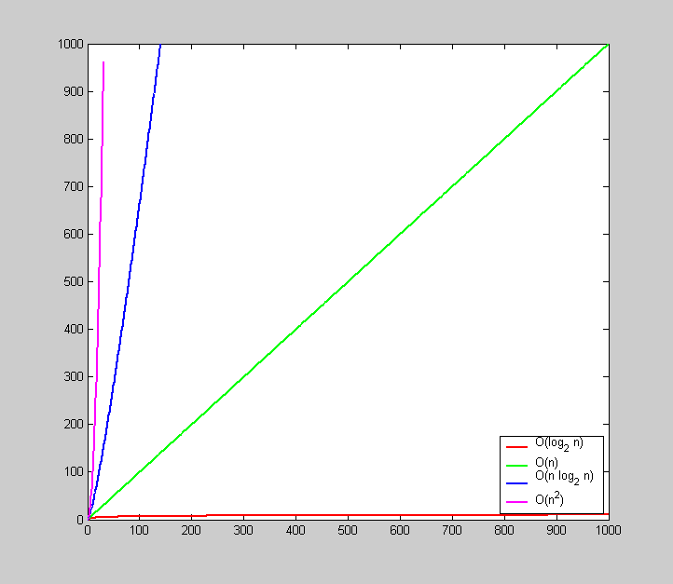
n²
n·log₂n
n
Faster is better!
log₂n

Slide 10
Stability
Stability: Does it rearrange the order of input data records which have the same key value (duplicates)?
e.g. Phone book sorted by name. Now sort by county – is the list still sorted by name within each county?
Extremely important property for databases
A stable sorting algorithm is one which does not rearrange the order of duplicate keys
Given 5 records r₁(7), r₂(5), r₃(8), r₄(3), and r₅(7) to be sorted, which of the following output is generated by a stable sorting algorithm?
Case 1: r₄(3) r₂(5) r₁(7) r₅(7) r₃(8)
Case 2: r₄(3) r₂(5) r₅(7) r₁(7) r₃(8)

Slide 11
Θ(n²) Sorting Algorithms

Slide 12
Bubble Sort
“Bubble” elements to their proper place in the array by comparing elements i and i+1, and swapping if A[i] > A[i+1]
Bubble every element towards its correct position
last position has the largest element
then bubble every element except the last one towards its correct position
then repeat until done

Slide 13
Bubble Sort
/* Bubblesort
* At the ith iteration, it keeps bubbling up the ith
* smallest value to position i in the array.
*/
template <typename E, typename Comp>
void bubsort(E A[], int n) {
for (int i=0; i<n-1; i++)
for (int j=n-1; j>i; j--)// from back to front
if (Comp::prior(A[j], A[j-1])) //compare
swap(A, j, j-1); //swap
}

Slide 14
Bubble Sort
n=8
0
1
2
3
4
5
6
7
42 | 42 | 42 | 42 | 42 | 42 | 42 | 42
20 | 20 | 20 | 20 | 20 | 20 | 20 | 13
17 | 17 | 17 | 17 | 17 | 17 | 13 | 20
13 | 13 | 13 | 13 | 13 | 13 | 17 | 17
28 | 28 | 28 | 28 | 14 | 14 | 14 | 14
14 | 14 | 14 | 14 | 28 | 28 | 28 | 28
23 | 23 | 15 | 15 | 15 | 15 | 15 | 15
15 | 15 | 23 | 23 | 23 | 23 | 23 | 23
13
42
13
20
13
17
14
28
15
23
i=0 j=7 j=6 j=5 j=4 j=3 j=2 j=1
i=1 j=7 j=6 j=5 j=4 j=3 j=2
i=2 j=7 j=6 j=5 j=4 j=3
i=3 j=7 j=6 j=5 j=4
i=4 j=7 j=6 j=5
i=5 j=7 j=6
i=6 j=7

Slide 15

Bubble Sort
“Bubble” elements to to their proper place in the array by comparing elements i and i+1, and swapping if A[i] > A[i+1]
We bubblize for i=1 to n-1 (i.e, n-1 times)
Each bubblization is a loop that makes n-i comparisons.
The total number of comparisons will be
roughly the same in the best, average, and worst cases.
The number of swaps can be expected about half the comparisons in the average case, leading to O (n²), in the average and worst cases. 0 swaps in the best case.
Bubble Sort is O(n²)

Slide 16
Selection Sort
In the ith pass of selection sort, the ith smallest key in the array is selected and placed into position i.
It searches through the entire unsorted portion to find the next smallest key value;
Only require one swap to put the record in place
The total number of swaps required will be n-1.
It is similar to Bubble Sort but requires much fewer swaps.

Slide 17
Selection Sort
/*
* Selection Sort
* In the ith pass, the ith smallest key in the array is selected * and placed into position i
*/
template <typename E, typename Comp>
void selsort(E A[], int n) {
for (int i=0; i<n-1; i++) { //select ith record
int lowindex = i; //Remember its index
for (int j=n-1; j>i; j--) //Find least value
if (Comp::lt(A[j], A[lowindex]))
lowindex = j; // Put it in place
swap(A, i, lowindex);
}
}

Slide 18
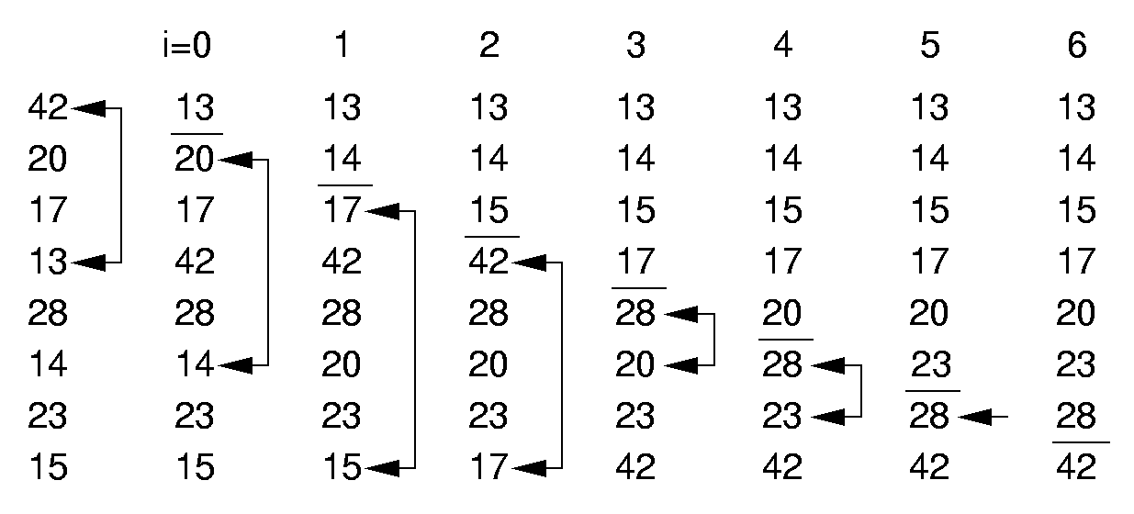
Selection Sort

Slide 19
Selection Sort
Time complexity analysis
The number of comparisons is Θ(n²) in the best, worst, and average cases
The number of swaps is
0 in the best case
n-1 in the worst case
Θ(n) in the average case

Slide 20
Insertion Sort
What if first k elements of array are already sorted?
4, 7, 12, 5, 19, 16
We can shift the tail of the sorted elements list down and then insert next element into proper position and we get k+1 sorted elements
4, 5, 7, 12, 19, 16

Slide 21
Insertion Sort
/*
* Insertion sort
* Each record is inserted in turn at the correct position
* within a sorted list composed of those records already
* processed
*/
template <typename E, typename Comp>
void insertionSort(E A[], int n) {
for (int i=1; i<n; i++) //insert i’th record
for (int j=i; (j>0) && (Comp::prior(A[j], A[j-1])); j--)
swap(A, j, j-1);// A[j] = A[j-1]
}

Slide 22
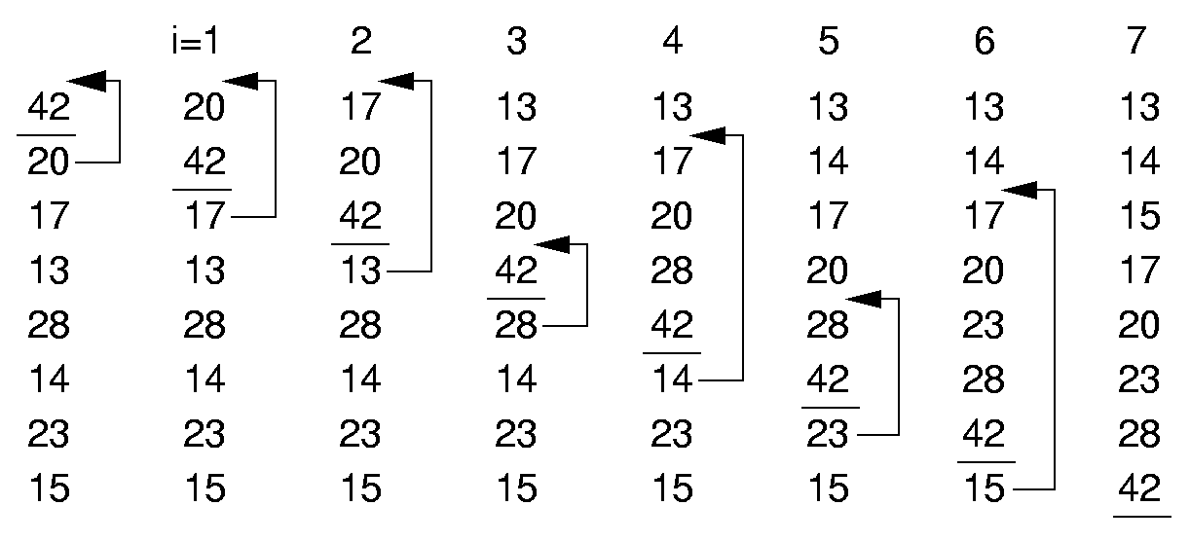
Insertion Sort
Input: an array of 8 records with key values 42 20 17 13 28 14 23 15

Slide 23
Insertion Sort
Time complexity analysis
Two nested for loops
Outer for loop executes n-1 times
Inner for loop: depends on the number of keys in positions 1 to i-1 that are smaller than the key in position i
Worst case: the input records are initially arranged in the reverse of the sorted order
The number comparisons is Σ_{i=2} ^{n} i ≈ n²/2 = Θ(n²)
Best case: the input records are already in sorted order
Every pass through the inner for loop fails immediately
The number comparisons is n-1 = Θ(n)

Slide 24
Insertion Sort
The number of comparisons and swaps is determined by the number of inversions in the input records
Inversion: a value is greater than a given value and also occurs prior to it in the array
We expect on average that half of the keys in the first i-1 array positions will have a value greater than that of the key at position i
The average-case cost is about half of the worst-case cost, i.e., around n²/4=Θ(n²)

Slide 25
Insertion Sort
# swaps vs. # comparisons
Every time through the inner for loop yields both a comparison and a swap, except that last which has no swap.
#swaps = #comparisons – (n-1)
#swaps is
0 in the best case
Θ(n²) in the average and worst cases

Slide 26
Insertion Sort Characteristics
In place and Stable
Running time
Worst case is O(N²)
reverse order input
must copy every element every time
Good sorting algorithm for almost sorted data
Each item is close to where it belongs in sorted order.

Slide 27
The Cost of Exchange Sorting
Comparison of the three algorithms
 | Insertion | Bubble | Selection
Comparisons:
Best Case | Θ(n) | Θ(n²) | Θ(n²)
Average Case | Θ(n²) | Θ(n²) | Θ(n²)
Worst Case | Θ(n²) | Θ(n²) | Θ(n²)
Swaps:
Best Case | 0 | 0 | Θ(n)
Average Case | Θ(n²) | Θ(n²) | Θ(n)
Worst Case | Θ(n²) | Θ(n²) | Θ(n)

Slide 28
The Cost of Exchange Sorting
The crucial bottleneck of the three algorithm is that only adjacent records are compared.
Comparisons and moves are by single steps.
Swapping happens between adjacent records – exchange sorts.
What is the average number of exchanges required when sorting a list L?
An inversion in an array of numbers is any ordered pair (i, j) having the property that i < j but a[i] > a[j].
The average number of inversions in an array of N distinct elements is n(n − 1)/4.
Define L_{R} to be the inverse of L. There are n(n-1)/2 distinct pairs of values in L (L_{R})
For each pair, it must either be an inversion in L or in L_{R}.
The total number of inversions in L and L_{R} is n(n-1)/2 for an average of n(n-1)/4 per list.
Any algorithm that sorts by exchanging adjacent elements requires Ω(n²) time on average.

Slide 29
Properties of Bubble,
Selection & Insertion
All three are in-place
Stable
BubbleSort is stable
SelectionSort is not stable
e.g. 3 9 3 2 5 -> 2 9 3 3 5 -> 2 3 3 9 5
InsertionSort is stable.

Slide 30
Shellsort
Shellsort makes comparisons and swaps between non-adjacent elements.
It tries to make the list “mostly sorted” so that a final insertion sort can finish the job.
Better performance than Θ(n²) in the worst case.
Central idea: divide and conquer
Break the list into sublists
Sort sublists individually
Recombine the sublists

Slide 31
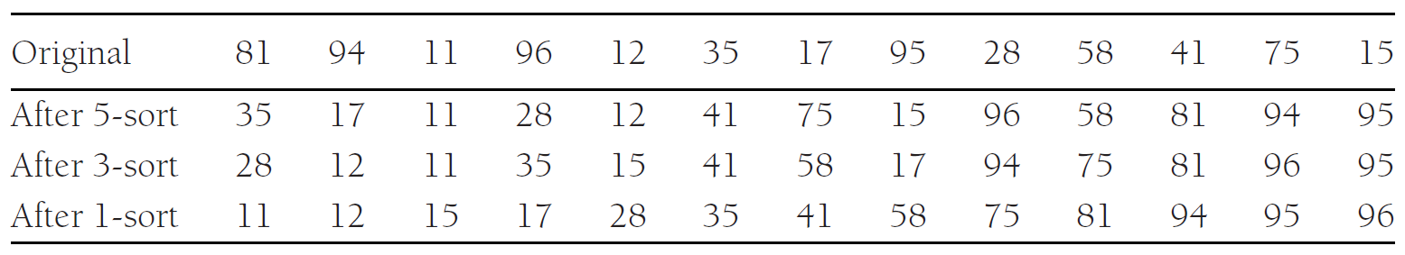
Shellsort
Shellsort is also called diminishing increment sort（缩小增量排序）.
Increment sequence h₁, h₂, . . . , h_{t}（步长）
After a phase, using some increment h_{k}, for every i, we have a[i] ≤ a[i + h_{k}]
All elements spaced h_{k} apart are sorted, h_{k}-sorted
An h_{k}-sorted file that is then h_{k−1}-sorted remains h_{k}-sorted
0
1
2
3
4
5
6
7
8
9
10
11
12

Slide 32
Shellsort
/**
* Shellsort, using Shell’s poor increments. h_{t} =floor( N/2), and * h_{k} = floor( h_{k+1}/2)
* Each sublist is sorted using Insertion Sort
*/
template <typename Comparable>
void shellsort( vector<Comparable> & a ) {
for( int gap = a.size( ) / 2; gap > 0; gap /= 2 )
for( int i = gap; i < a.size( ); ++i )
{
Comparable tmp = std::move( a[ i ] );
int j = i;
for( ; j >= gap && tmp < a[ j - gap ]; j -= gap )
a[ j ] = std::move( a[ j - gap ] );
a[ j ] = std::move( tmp );
}
}

Slide 33
Shellsort
/**
* Shellsort, using Shell’s poor increments. h_{t} =floor( N/2), and * h_{k} = floor( h_{k+1}/2)
* Each sublist is sorted using Insertion Sort
*/
template <typename Comparable>
void shellsort( vector<Comparable> & a ) {
for( int gap = a.size( ) / 2; gap > 0; gap /= 2 )
for( int i = gap; i < a.size( ); ++i )
{
Comparable tmp = std::move( a[ i ] );
int j = i;
for( ; j >= gap && tmp < a[ j - gap ]; j -= gap )
a[ j ] = std::move( a[ j - gap ] );
a[ j ] = std::move( tmp );
}
}

Slide 34
Shellsort
Modified version of Insertion Sort for varying increments
Insertion Sort among a set of elements with gapped positions.
// Modified version of Insertion Sort
template <typename E, typename Comp>
void inssort2(E A[], int n, int incr) {
for (int i=incr; i<n; i+=incr)
for (int j=i; (j>=incr) && (Comp::prior(A[j], A[j-incr]));
j-=incr)
swap(A, j, j-incr);
}
//Shellsort
template <typename E, typename Comp>
void shellsort(E A[], int n) {
for (int i=n/2; i>2; i/=2) //For each increment
for (int j=0; j<i; j++) //Sort each sublist
inssort2<E,Comp>(&A[j], n-j, i);
//Normal insertion sort
inssort2<E,Comp>(A, n, 1);
}

Slide 35
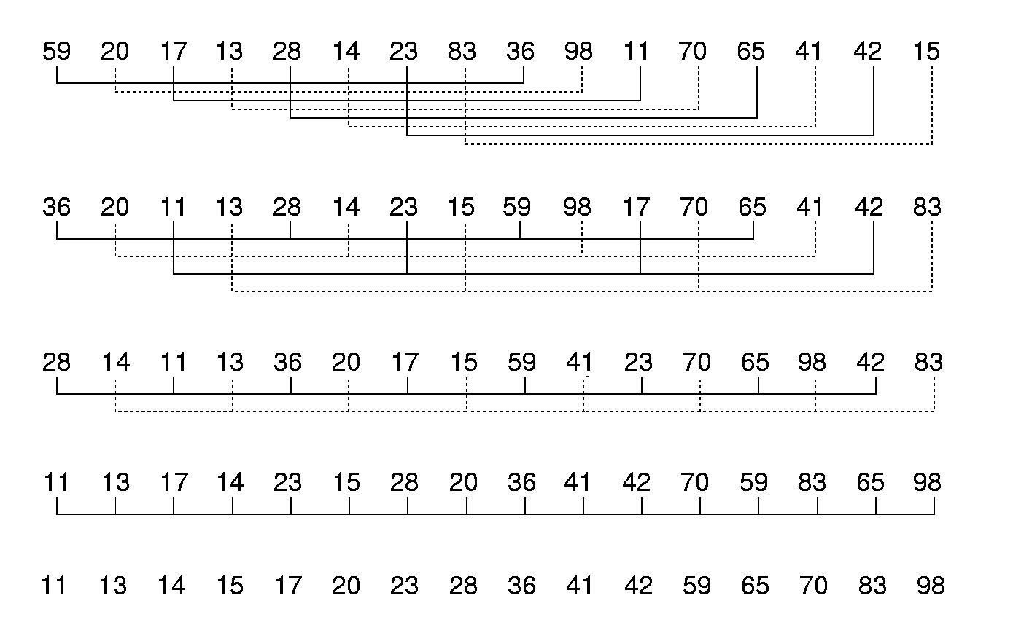
Shellsort
for (int j=0; j<i; j++) //for sublist
inssort2<E,Comp>(&A[j], n-j, i);
28
36
59
65
28 14
36 20
59 41
65 98
28 14 11
36 20 17
59 41 23
65 98 42

Slide 36
Shellsort (VI)
for (int i=n/2; i>2; i/=2)
for (int j=0; j<i; j++)
inssort2<E,Comp>(&A[j], n-j, i);
inssort2<E,Comp>(A, n, 1);

Slide 37
Shellsort
Shellsort conclude with a regular Insertion Sort
The complexity will be at least the complexity of Insertion Sort?
Each of the sublist sorts will make the list “more sorted” than it was before, which leads to a relatively cheap final Insertion Sort pass.
Choice of increments also influences the efficiency

Slide 38
Analysis of Shellsort
Shellsort is a very simple algorithm with an extremely complex analysis.
The worst-case running time of Shellsort using Shell’s increments is Θ(N²).
Shell’s increments: h_{t}=floor(N/2), h_{k}=floor( h_{k+1}/2)

Slide 39
Analysis of Shellsort
The worst-case running time of Shellsort using Hibbard’s increments is Θ (N^{3/2}).
Hibbard’s increments: 1, 3, 7, . . . , 2^{k} − 1
The key difference is that consecutive increments have no common factors
The average-case running time of Shellsort, using Hibbard’s increments, is thought to be O(N^{5/4}).(not proven)
The worst-case running time of Shellsort using Sedgewick’s increments is O(N^{4/3}), O(N^{7/6}) for the average-case.
Sedgewick’s increments: 1, 5, 19, 41, 109, . . ., (9 · 4^{i} − 9 · 2^{i} + 1 or 4^{i} − 3 · 2^{i} + 1). (best known in practice)

Slide 40
Properties of Shellsort
Shellsort is in-place
Shellsort is not stable
3 5 10 8 7 2 8 1 20 6
Gap = 2
3 1 7 2 8 5 10 6 20 8

Slide 41
Homework 5-1
To Implement all sorting algorithms discussed. (The mission is not homework.)
Textbook exercises 7.2, 7.4, 7.9
Deadline: to be confirmed.

